Slide 1

Developing a Personal Student Webpage
R. W. Pfeifle
2 August 2022
GMU FOCUS Camp 2022

Slide 2

Spectrum
Spectrum is a student group dedicated to fostering a diverse, inclusive, and scientifically-minded community among graduate and undergraduate physics and astronomy students.
Come see Spectrum at the Fairfax Fall Festival on October 8th!
There’ll be merchandise, NASA swag, and Ask a Scientist!
Spectrum Website: https://gmuspectrum.squarespace.com

Slide 3
Why build a webpage?
College admissions committees and faculty will look up your name after you apply:
If you have an easily accessible website, search committees can easily gather more information about you as a candidate.
Use this to your advantage! Show off things you did not have space for in your application and offer more details about things that were in your application.
Other researchers will look for details about your work and your current status:
This can be related to an interest in:
Collaborating on a project
Seeking new students (graduate students, or postdoctoral fellows)
Connecting you with a student
Other students (grad or undergrad) will look for details on your work:
They might do this to see what kind of research is happening in your group or at your school
They might do this to gather information about your advisor (if they are seeking an advisor)
They might do this motivate themselves or draw new ideas from your web presence

Slide 4
Why build a webpage?
College admissions committees and faculty will look up your name after you apply:
If you have an easily accessible website, search committees can easily gather more information about you as a candidate.
Use this to your advantage! Show off things you did not have space for in your application and offer more details about things that were in your application.
Other researchers will look for details about your work and your current status:
This can be related to an interest in:
Collaborating on a project
Seeking new students (graduate students, or postdoctoral fellows)
Connecting you with a student
Other students (grad or undergrad) will look for details on your work:
They might do this to see what kind of research is happening in your group or at your school
They might do this to gather information about your advisor (if they are seeking an advisor)
They might do this motivate themselves or draw new ideas from your web presence

Slide 5
Why build a webpage?
College admissions committees and faculty will look up your name after you apply:
If you have an easily accessible website, search committees can easily gather more information about you as a candidate.
Use this to your advantage! Show off things you did not have space for in your application and offer more details about things that were in your application.
Other researchers will look for details about your work and your current status:
This can be related to an interest in:
Collaborating on a project
Seeking new students (graduate students, or postdoctoral fellows)
Connecting you with a student
Other students (grad or undergrad) will look for details on your work:
They might do this to see what kind of research is happening in your group or at your school
They might do this to gather information about your advisor (if they are seeking an advisor)
They might do this motivate themselves or draw new ideas from your web presence

Slide 6
The most basic way to make an html index page
Now we need to demonstrate how to create and upload a basic, basic webpage file.
Open a text editor (for example: TextWrangler, VSCode, TextEdit, vim, etc.)
Within the text file, type anything (a test phrase or start building your website!)
I’ll just use ‘Hello World!’
Save the text file as index.html
Open a folder where you saved the index.html file.
Double-click the file, and it will open in your browser for you to view.
You should see whatever you typed into the index.html file!

Slide 7
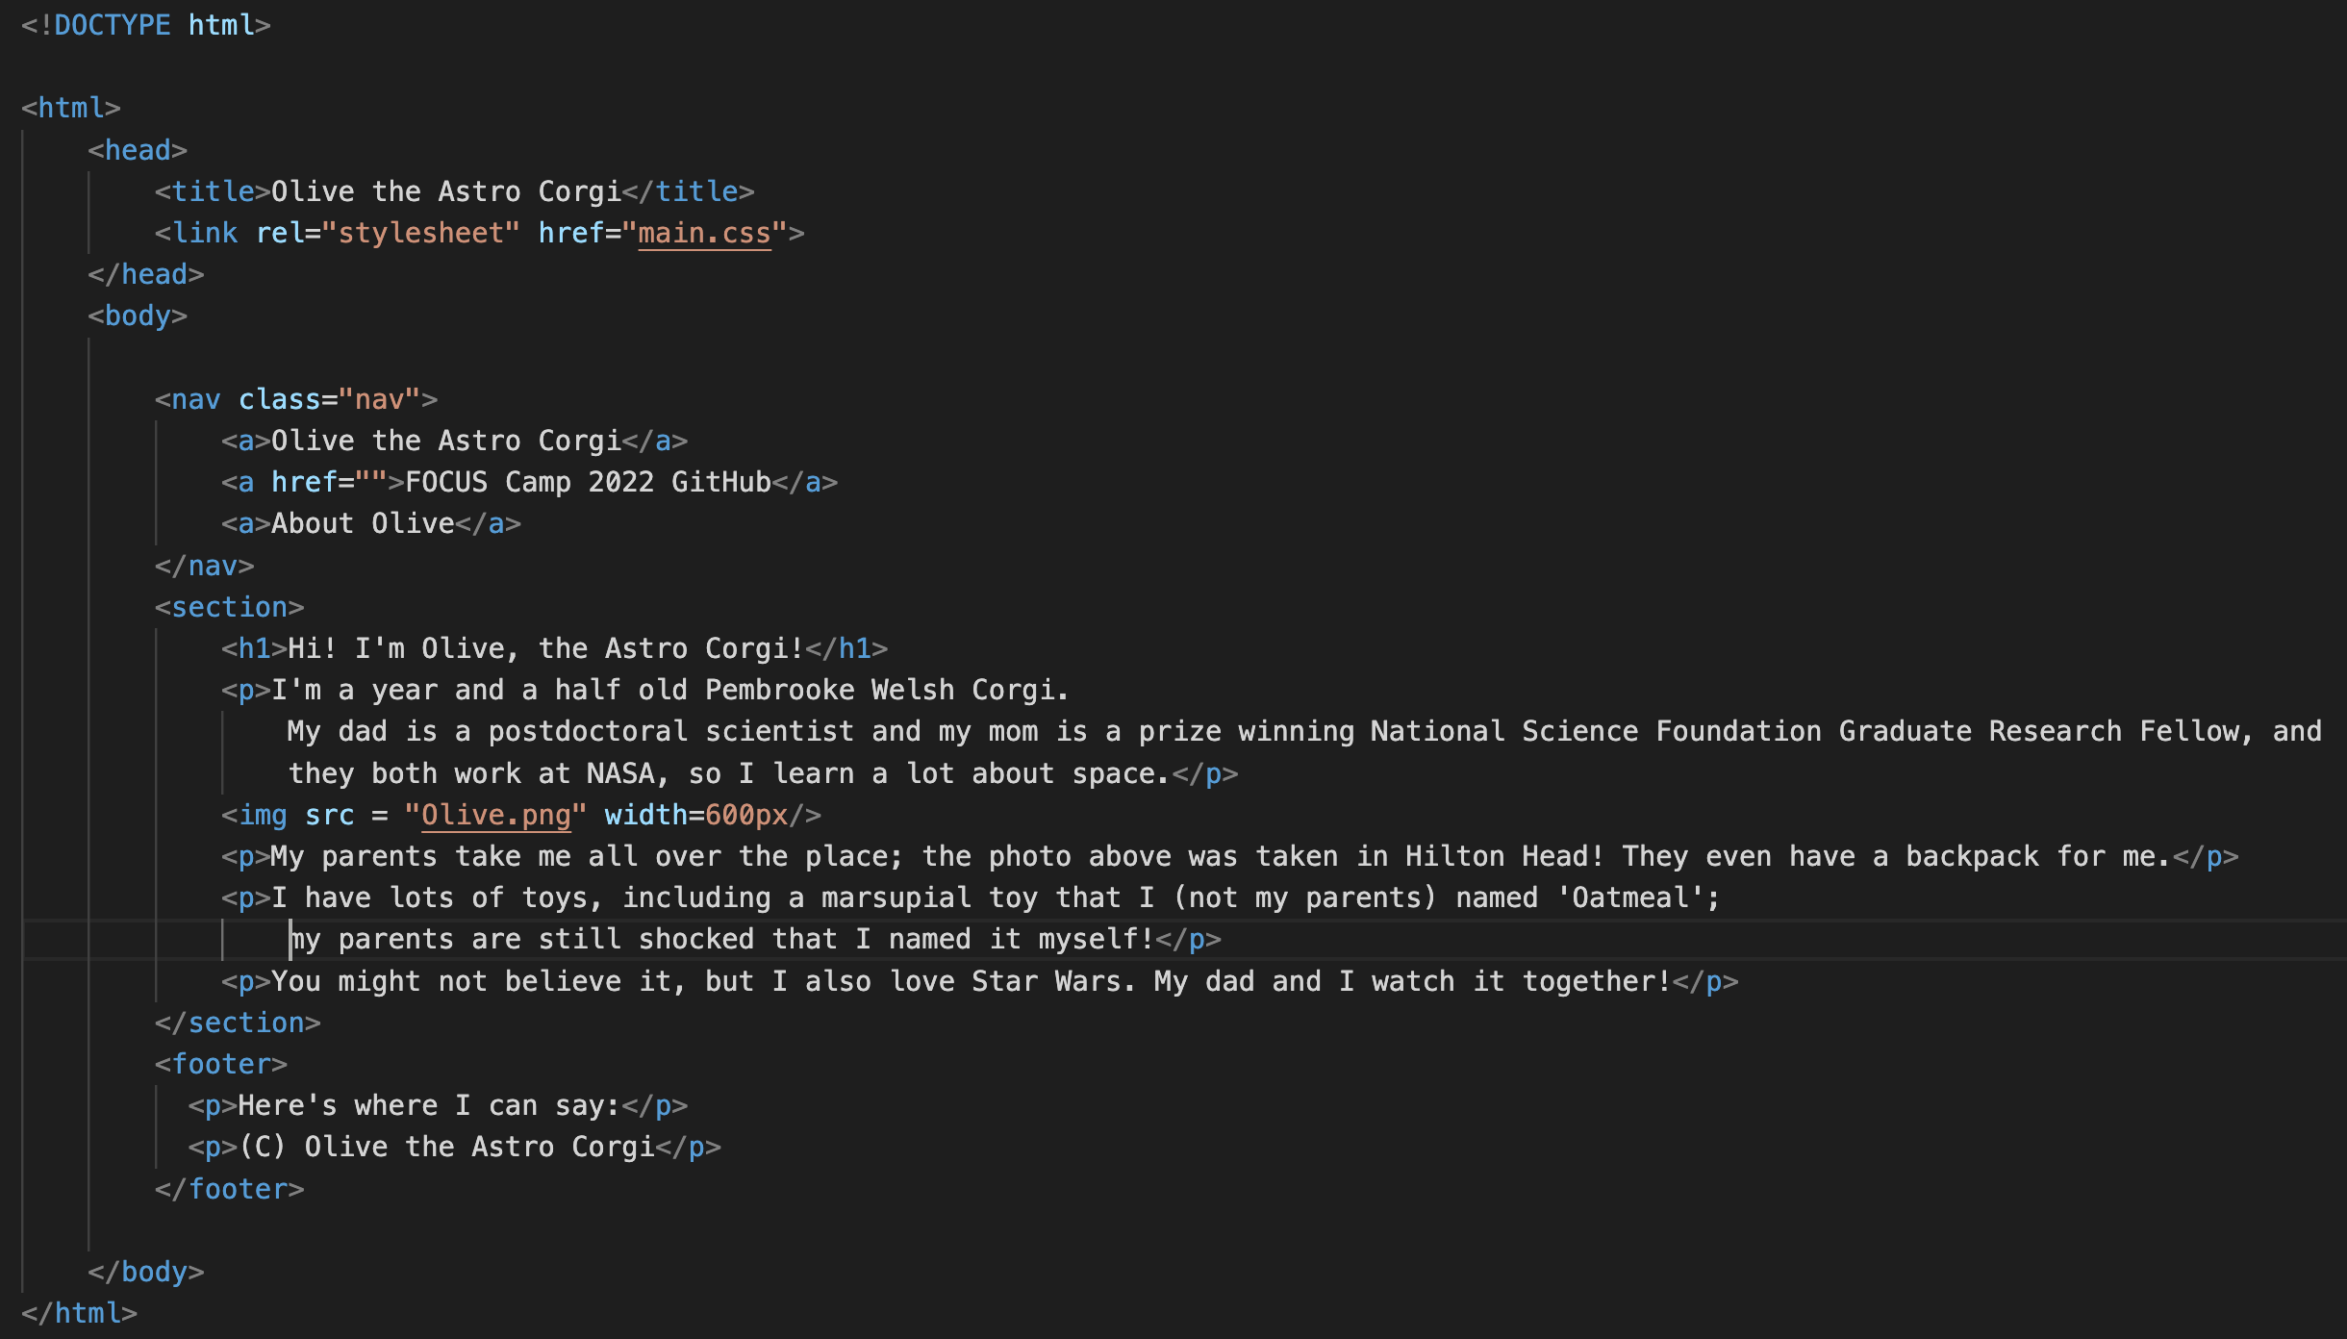
Now for a little formatting: An HTML Walkthrough
Now we’ll add a few more elements to our HTML file to provide some titles, text, and an image.
(We’ll do this all together right now!)

Slide 8
Now for a little formatting: An HTML Walkthrough
These are ‘elements’
Now we’ll add a few more elements to our HTML file to provide some titles, text, and an image.
(We’ll do this all together right now!)

Slide 9
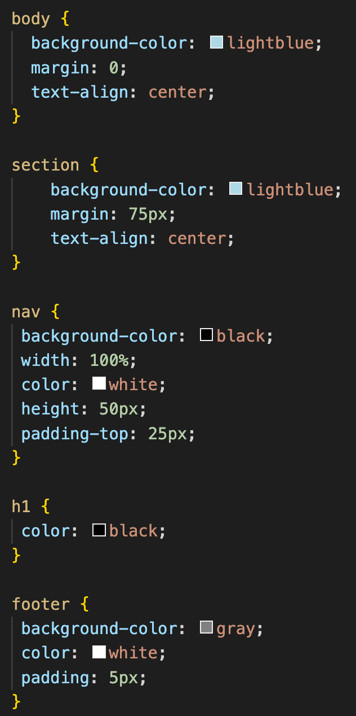
Now for a little formatting: A CSS Walkthrough
Now we’ll add a CSS file, which will store commands for how we want our website formatted!
We’ll define several ‘classes’ that our HTML file will use for formatting.
Here we can define the background colors, define specific sections, and width of the website/website sections, text alignment, and much, much more!
Type the commands in a new file, and save this file as ‘main.css’
(We’ll do this all together right now!)

Slide 10
Additional Helpful tutorials and links
5HTML UP and hosting your website on GitHub:
https://astrosites.github.io/tutorial/
https://pages.github.com
Introductory materials for GitHub (good if you want to start using it for your website or coding projects):
https://docs.github.com/en/get-started/quickstart/hello-world
Here’s the helpful page where I pulled the HTML and CSS commands for our simple website versions:
https://www.freecodecamp.org/news/web-development-for-beginners-basic-html-and-css/
It has helpful explanations!
W3Schools guides and tutorials:
For HTML: https://www.w3schools.com/html/default.asp
For CSS: https://www.w3schools.com/css/default.asp

Slide 11
Now for something a little more fancy: 5HTML UP
5HTML UP offers 100% free web templates which are easily customizable and fully responsive!
https://html5up.net
Several dozen templates are currently available to choose from.
Here are a few examples of webpages made using 5HTML UP:
https://mason.gmu.edu/~rpfeifle/
https://mason.gmu.edu/~nlatouf/index.html
https://peterboorman.com

Slide 12
5html up: a more professional webpage format
5HTML UP offers 100% free web templates which are easily customizable and fully responsive!
https://html5up.net
Several dozen templates are currently available to choose from.
Step 1: Download the template of your choice.
Step 2: Open downloaded folder
Double click in index.html file. This opens your local file in your internet browser so you can inspect it.
Step 3: Edit the index.html file as you see fit.
Step 4: Upload to your web host

Slide 13
5html up: a more professional webpage format
Step 1: Download the template of your choice.
Step 2: Open downloaded folder
Double click in index.html file. This opens your local file in your internet browser so you can inspect it.
Step 3: Edit the index.html file as you see fit.
Step 4: Upload to your web host

Slide 14
5html up: a more professional webpage format
Step 1: Download the template of your choice.
Step 2: Open downloaded folder
Double click in index.html file. This opens your local file in your internet browser so you can inspect it.
Step 3: Edit the index.html file as you see fit.
Step 4: Upload to your web host

Slide 15
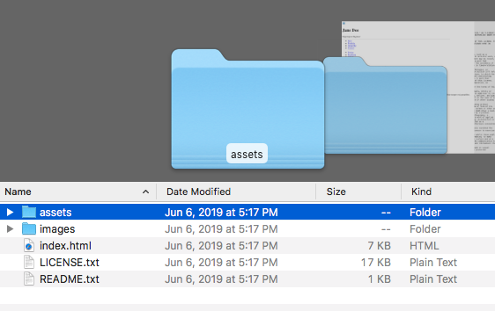
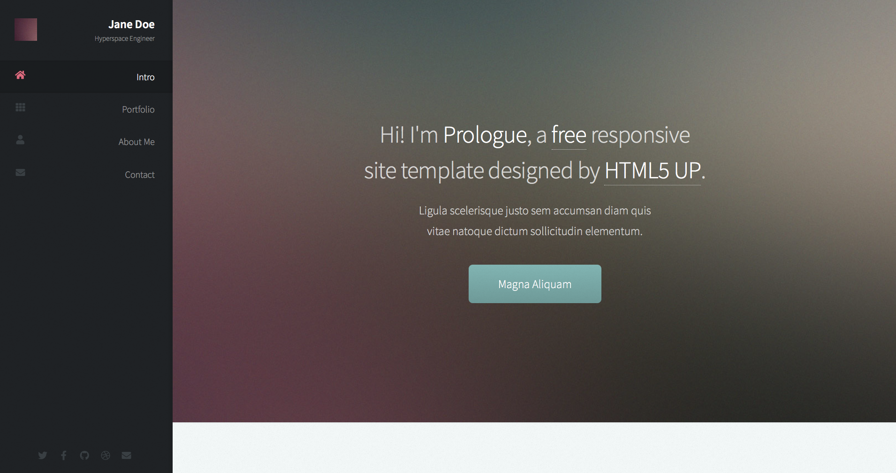
Inspecting the template
(1) Open the downloaded folder to view contents:
(3) The template will now be open in your browser:
(2) Double click on index.html to inspect the local file in your browser.
(4) Inspect the template in your browser. Note changes you want to make.

Slide 16
5html up: a more professional webpage format
Step 1: Download the template of your choice.
Step 2: Open downloaded folder
Double click in index.html file. This opens your local file in your internet browser so you can inspect it.
Step 3: Edit the index.html file as you see fit.
Inspect the changes made to the index.html file by double clicking it and viewing it in the browser throughout this process.
I’m going to use VSCode to edit my index.html file.
Step 4: Upload to your web host

Slide 17
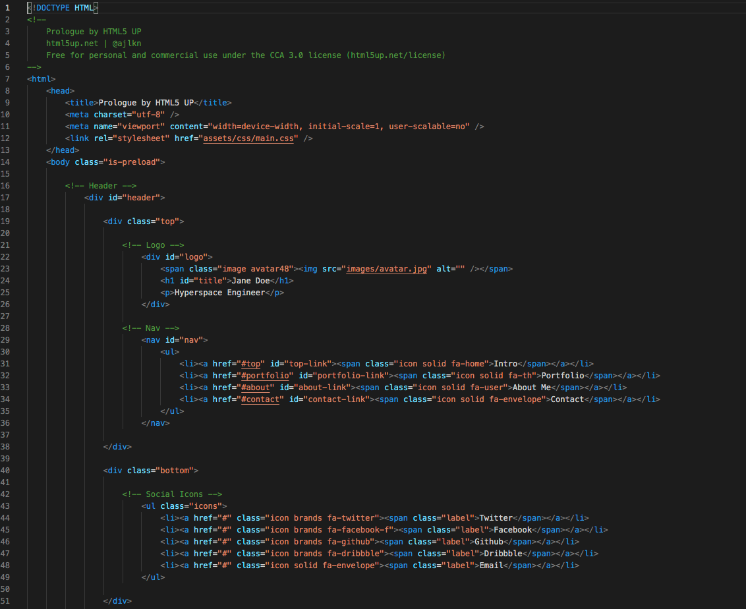
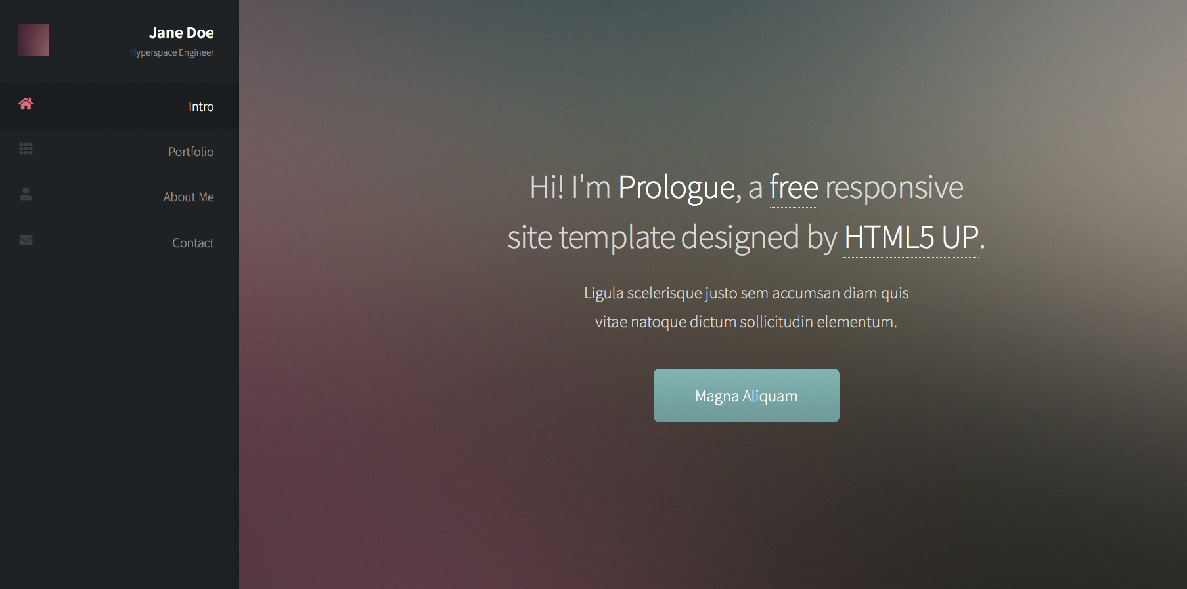
Editing your index.html file

Slide 18
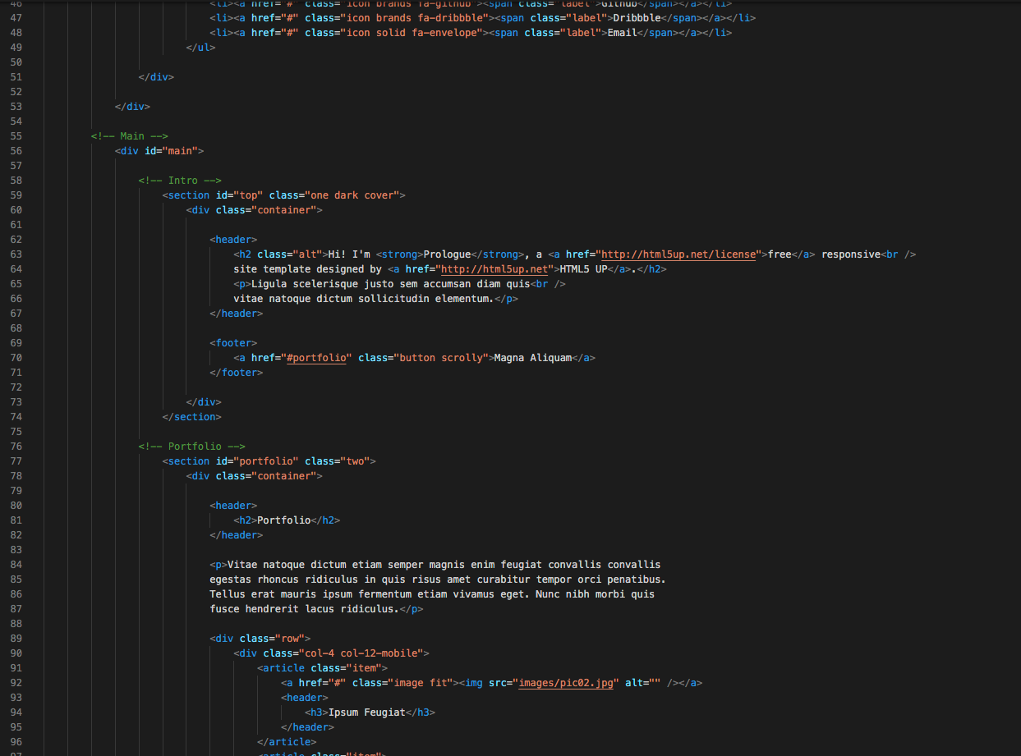
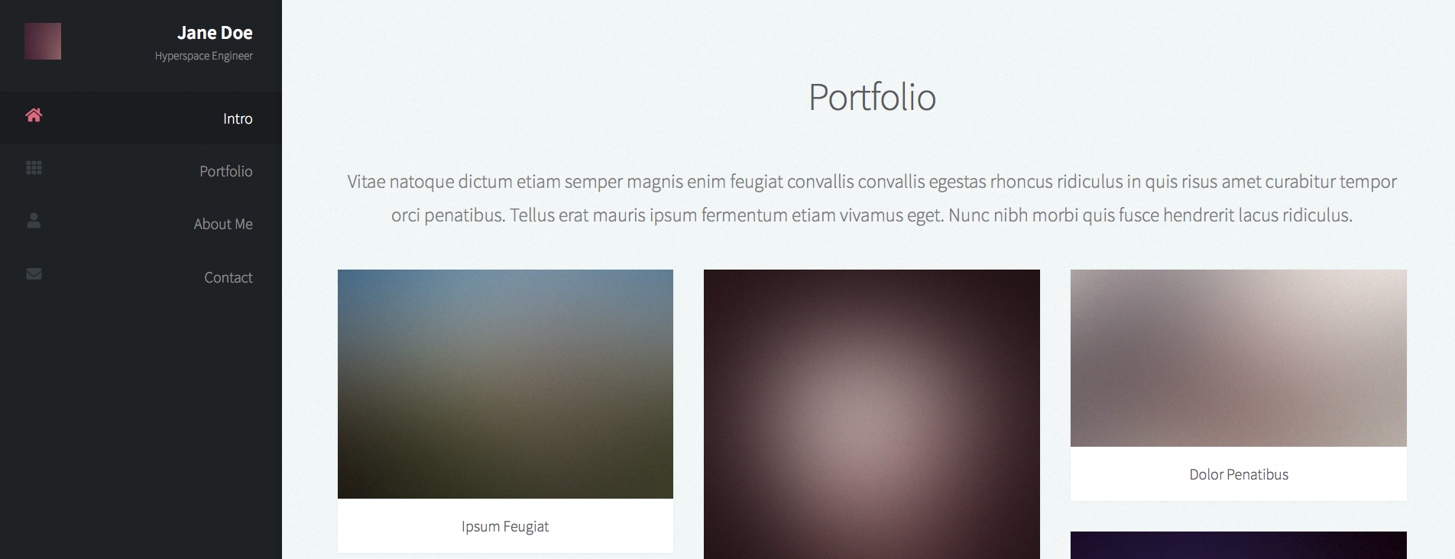
Editing your index.html file

Slide 19
5html up: a more professional webpage format
Step 1: Download the template of your choice.
Step 2: Open downloaded folder
Double click in index.html file. This opens your local file in your internet browser so you can inspect it.
Step 3: Edit the index.html file as you see fit.
Inspect the changes made to the index.html file by double clicking it and viewing it in the browser throughout this process.
I’m going to use VSCode to edit my index.html file.
Step 4: Upload to your web host

Slide 20

Uploading to github
GitHub is a free-to-use platform for hosting your own coding projects and includes a free space for website hosting. The best part? It’s easy!
First: make a GitHub account:

Slide 21
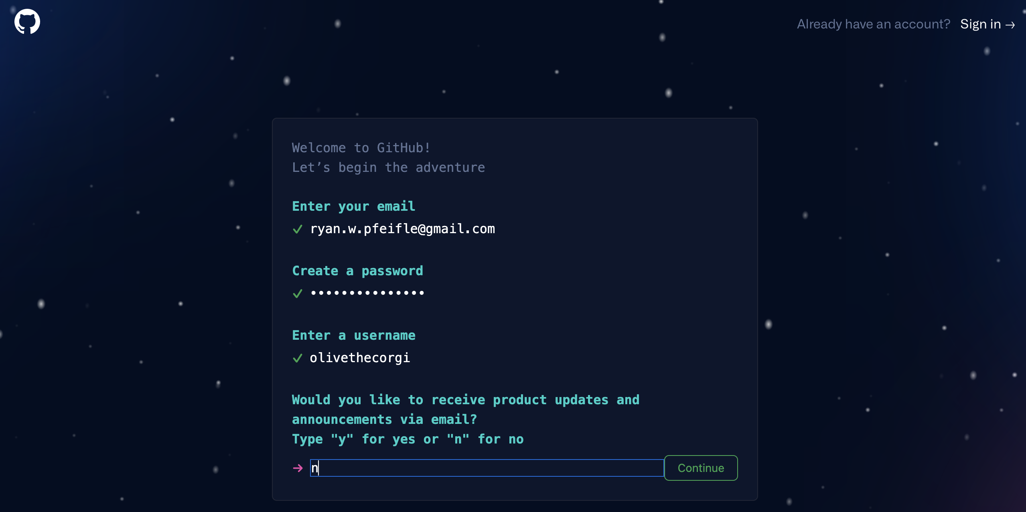
Create your github account
Enter your email address
Create a good password
Enter a username
Type ‘n’

Slide 22
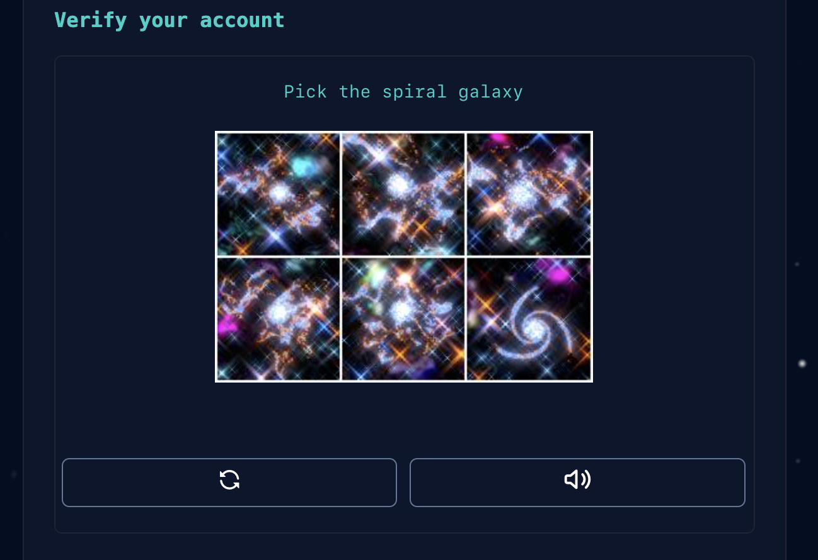
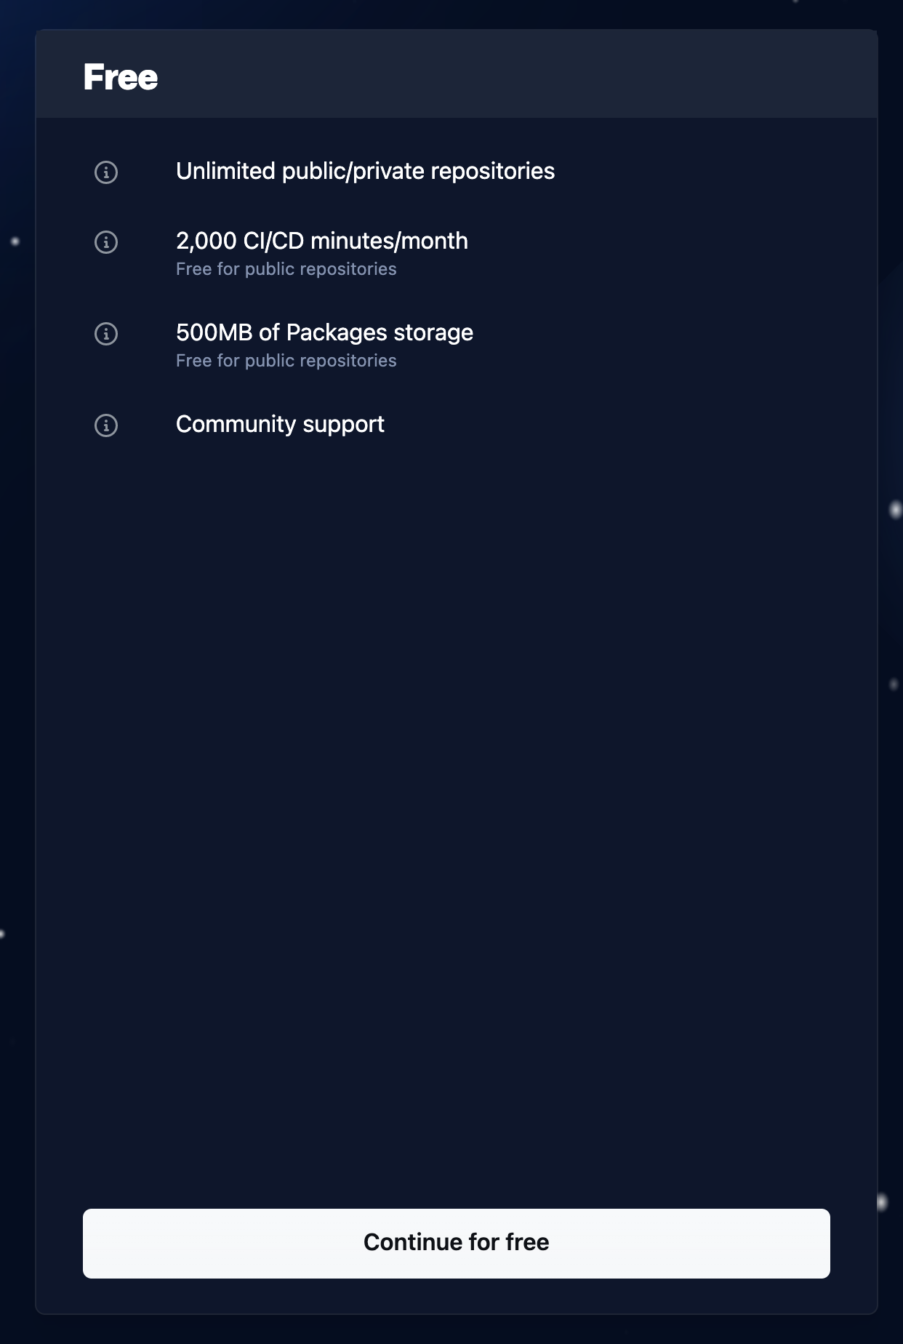
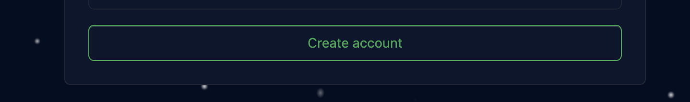
Fill out the puzzle to verify your account:
Select the free option:
Click “Create Account”
Supply the code that GitHub emailed you!

Slide 23
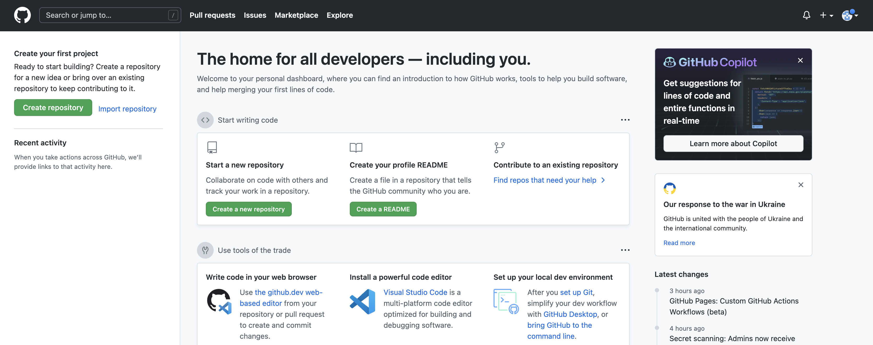
Create your first repository

Slide 24
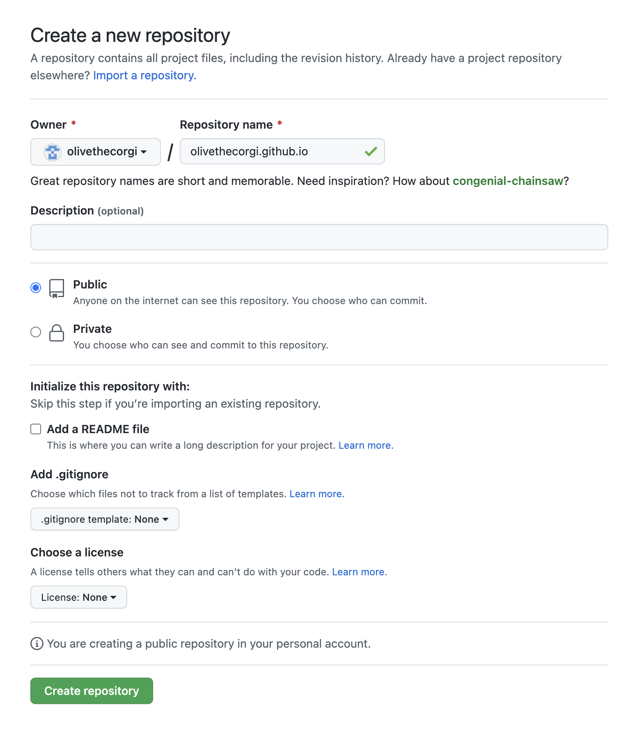
Creating Your Repository
Name your repository appropriately!
If your username is `olivethecorgi`, your repository for your website should be named:
olivethecorgi.github.io
Make sure the repository is public!
Do not add a README file

Slide 25
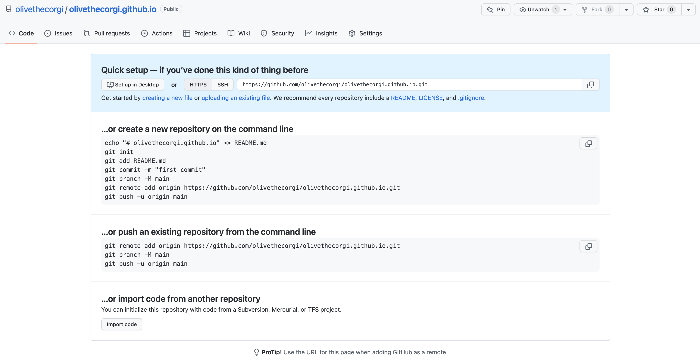
Upload your files to the repo

Slide 26
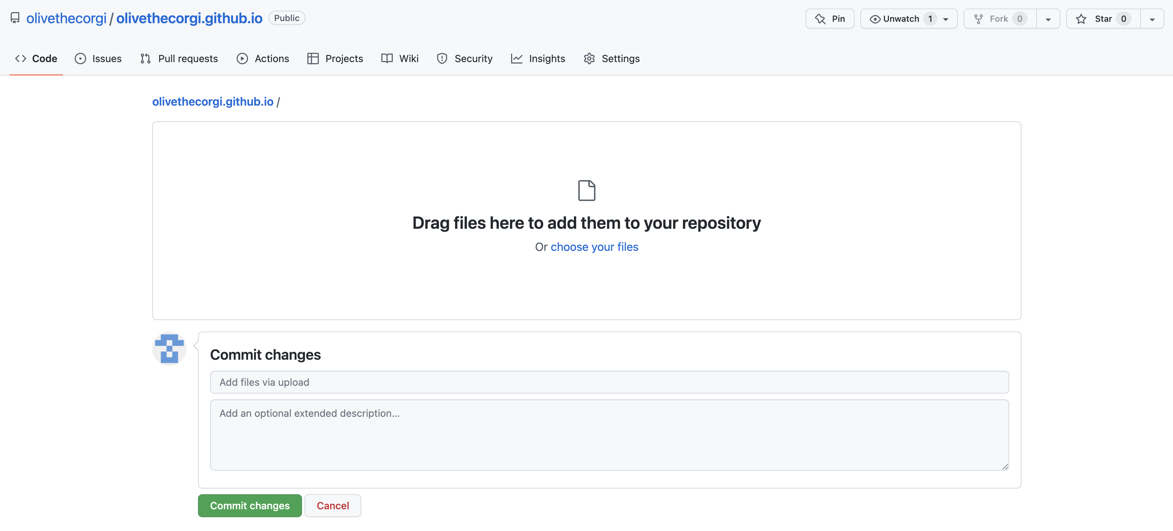
Upload your files

Slide 27
Tips for making your webpage visible
Make sure to add links to your webpage on your social media accounts.
High visibility to allow search engines like Google to find your website more easily. More traffic (via people actually clicking on your web link) will also make it easier to find.
Register your website with Google: https://search.google.com/search-console/about
This will help Google make your webpage visible on the first page of results.
Make sure to put your name in the title of your website and within the text of your html files. This way, when people google your name, your website should be within the search results.
NEVER put sensitive information (like passwords, social security numbers, or other important personal info) on your website or in your HTML/CSS documents!

Slide 28
Additional Helpful tutorials and links
5HTML UP and hosting your website on GitHub:
https://astrosites.github.io/tutorial/
https://pages.github.com
Introductory materials for GitHub (good if you want to start using it for your website or coding projects):
https://docs.github.com/en/get-started/quickstart/hello-world
Here’s the helpful page where I pulled the HTML and CSS commands for our simple website versions:
https://www.freecodecamp.org/news/web-development-for-beginners-basic-html-and-css/
It has helpful explanations!
W3Schools guides and tutorials:
For HTML: https://www.w3schools.com/html/default.asp
For CSS: https://www.w3schools.com/css/default.asp

